Slide 1
AN AUTOMATED EMAIL SERVICE BY CONVERSATIONAL AI
DOMAIN : Artificial Intelligence
TEAM MEMBERS :
1) HARIRAM B - 212219220012
2) ANANDASAYANAM K - 212219220002
3) MAHESWARA PANDIAN G - 212219220029

Slide 2
ABSTRACT :
Electronic mail (email or e-mail) is a method of exchanging messages (“mail”) between people using electronic devices. Email operates across computer networks, primarily the Internet. In this project model, a user can send text messages through voice by a conversational Artificial intelligence to a recipient. The conversational AI recognizes user’s speech and input and perform operations accordingly.

Slide 3
OBJECTIVE :
To send email message to a recipient (without typing) by speaking to a conversational AI.

Slide 4
ADVANTAGES :
Chatbots are always supposed to be the superstars of artificial intelligence for customer service. These chatbots help customers in solving their problems faster and accurately. Thus, they similarly perform as outstanding assistants to agents.
Eliminate Tedious Time-Consuming Tasks and save time.

Slide 5
CHALLENGES :
1. Security and privacy :
At the point when users demand a voice assistant, the information sent must be safely prepared and put away.
2. Discovery and adoption : Although Conversational AI applications are getting progressively simple to use and standardized for everybody, there are still difficulties that can be defeated to expand the number of individuals who are open to using technology for a more extensive variety of use cases.

Slide 6
LITERATURE REVIEW :
Xinmeng Song (2021) Based on the results, we find the following insights: (1) The evolution of conversational AI research involves many categories while two major disciplines—computer science and ergonomics—lead the way. (2) The current research can be divided into two research areas: underlying technology architecture and smart scene applications. By using multiple complementary scientometric methods, our study visually presents the research history, current research hotspots and emerging trends in the field of conversational AI, to further promote its technology and application research.

Slide 7
2. Rui Yan (2018), states Conversational AI is of growing importance since it enables easy interaction interface between humans and computers.To build a conversational system with moderate intelligence is challenging, and requires abundant dialogue data and interdisciplinary techniques. A-long with the Web 2.0, the massive data available greatly facilitate data-driven methods such as deep learning for human-computer conversations. In general, conversational systems can be categorized into 1) task-oriented systems which aim to help users accomplish goals in vertical domains, and 2) social chat bots which can converse seamlessly and appropriately with humans, playing the role of a chat companion. In this paper, we focus on the survey of non-task-oriented chit-chat bots.

Slide 8
3. Sinarwati Mohamad Suhaili, Naomie Salim, Mohamad Nazim Jambli (2021) The primary purpose of this literature review is to identify and study the existing literature on cutting-edge technology in developing chatbots in terms of research trends, their components and techniques, datasets and domains used, as well as evaluation metrics most used between 2011 and 2020. Using the standard SLR guidelines designed by Kitchenham, this work adopts a systematic literature review approach and utilizes five prestigious scientific databases for identifying, extracting, and analyzing all relevant publications during the search. The related publications were filtered based on inclusion/exclusion criteria and quality assessment to obtain the final review paper. The results of the review indicate that the exploitation of deep learning and reinforcement learning architecture is the most used technique to understand users’ requests and to generate appropriate responses.

Slide 9
EXISTING SYSTEM :
Today’s email systems are based on a store-and-forward model. Email servers accept, forward, deliver, and store messages. Neither the users nor their computers are required to be online simultaneously; they need to connect, typically to a mail server or a webmail interface to send or receive messages or download it. The users send text messages only by typing or forwarding.

Slide 10
PROPOSED SYSTEM :
By the existing method, the user can only type the message or forward it to a recipient. But by this project model, a user can speak to a conversational AI and send email without typing. Conversational AI studies human conversation and language processing to mimic speech and make the user feel like they are merely talking to another person. This is exactly what developers want conversational AI to imitate. When technology conveys emotion and meaning, the user feels more comfortable conversing with it.

Slide 11
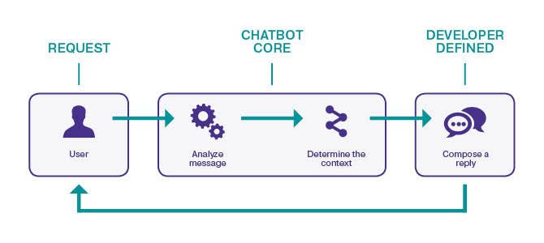
DIAGRAM OF PROPOSED SYSTEM :

